Slide 1
PROJECT ON ETHICAL HACKING
MADE BY- ASTHA SINGH
UNDER THE GUIDANCE OF INTERNSHIP STUDIO

Slide 2
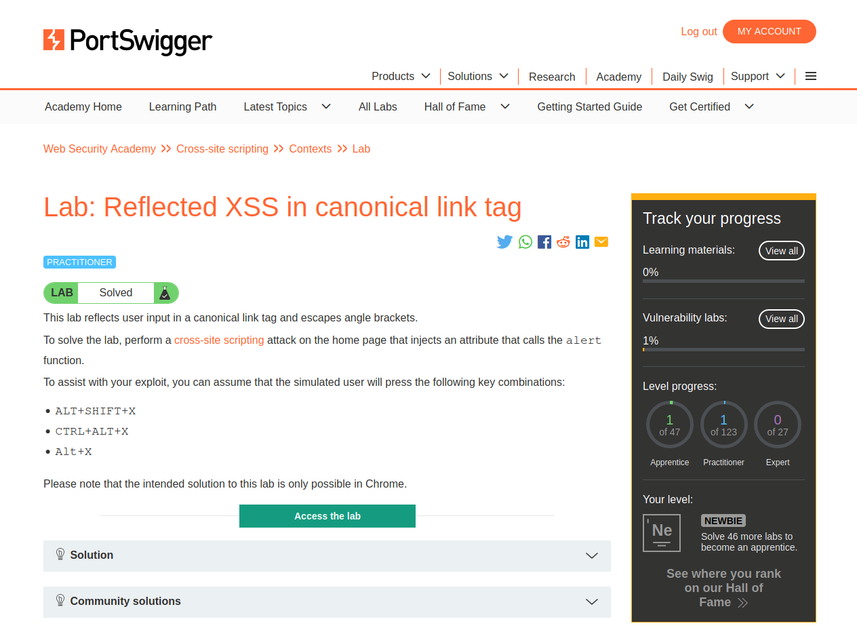
TASK 1:
SOLVED LABS USING TEMP-MAIL TO HIDE IDENTITY AND MADE A LOGIN ACCOUNT IN PORTSWIGGER
Reflected XSS in Canonical
Tag

Slide 3
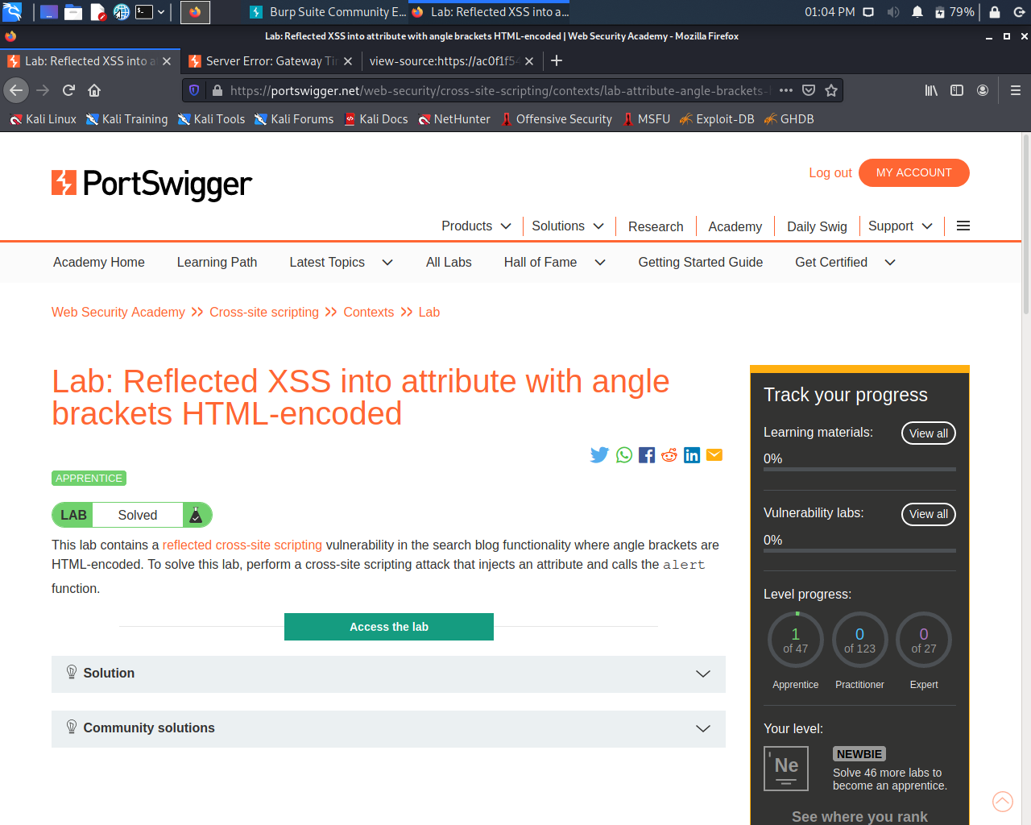
.
2. REFLECTED XSS INTO ATTRIBUTE WITH ANGLE BRACKETS HTML-ENCODED
.

Slide 4
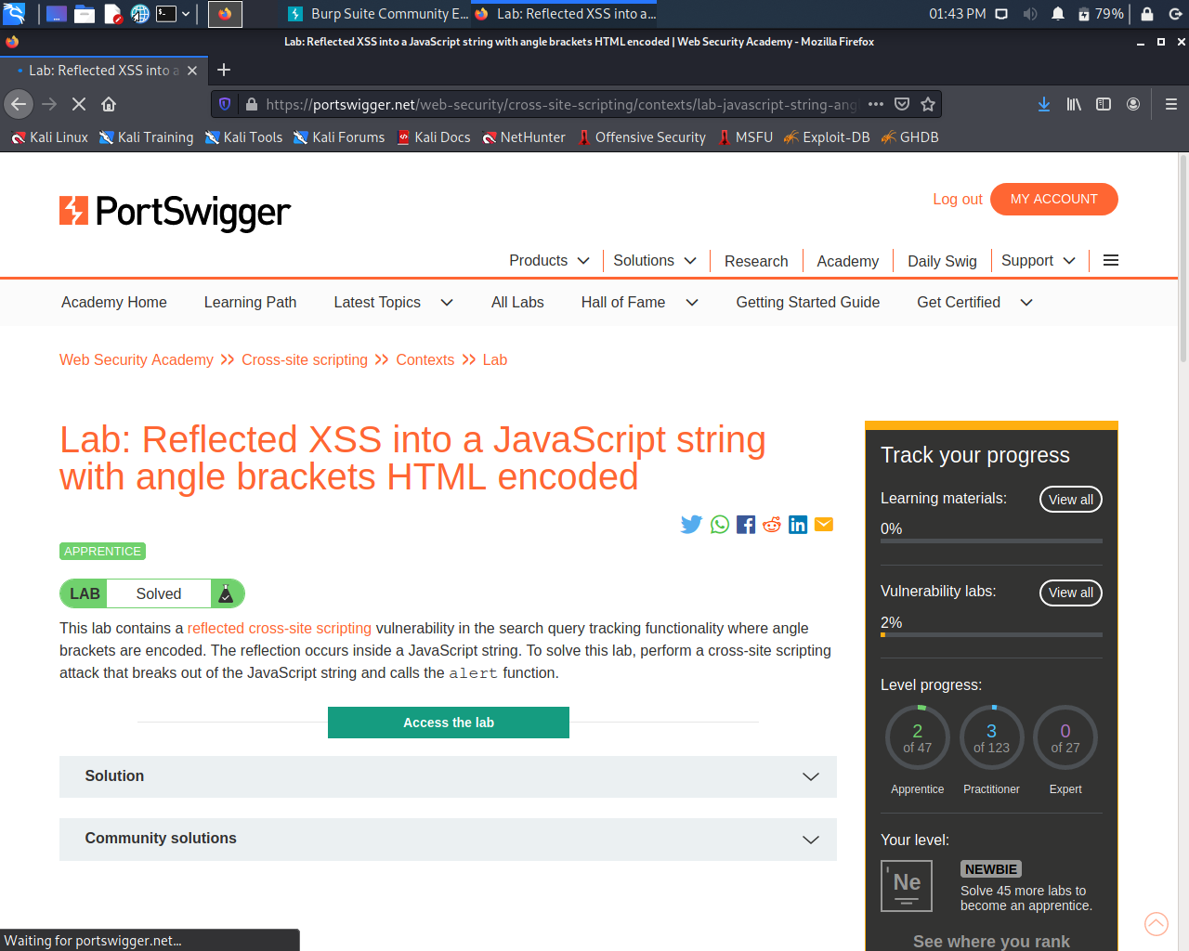
.
3. REFLECTED XSS INTO A JAVASCRIPT STRING WITH ANGLE BRACKETS HTML ENCODED
.

Slide 5
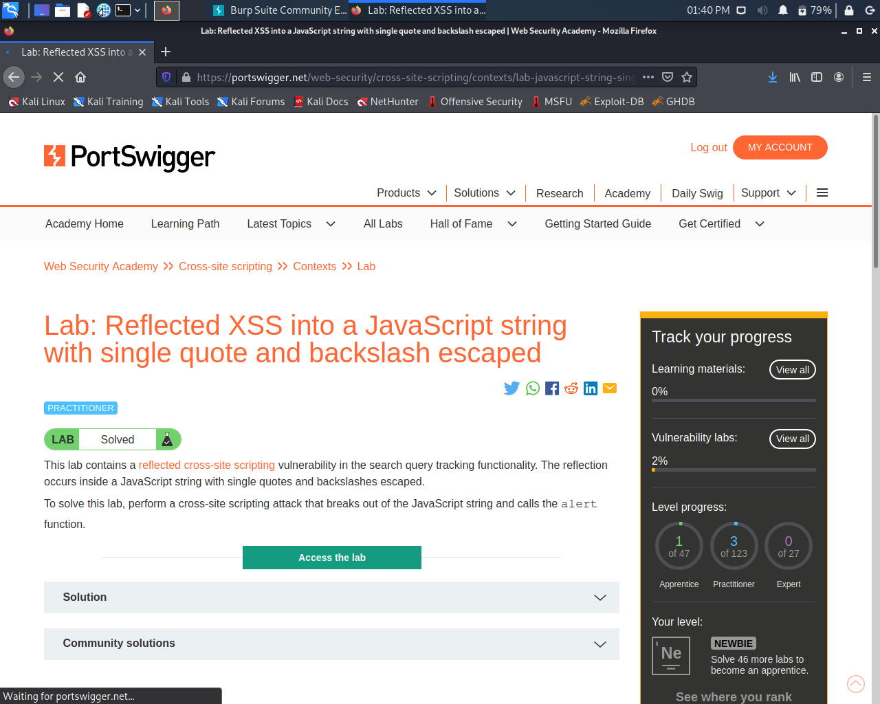
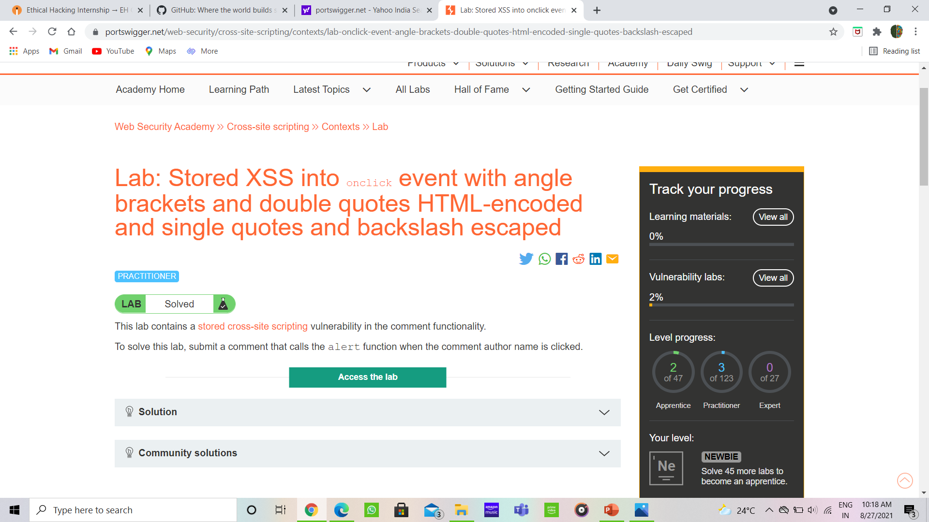
.
4. REFLECTED XSS INTO A JAVASCRIPT STRING WITH SINGLE QUOTE AND BLACKSLASH ESCAPED
5. STORED XSS INTO ONCLICK EVENT ANGLE BRACKETS AND DOUBLE QUOTES HTML ENCODED AND SINGLE QUOTES AND BACKSLASH ESCAPED

Slide 6
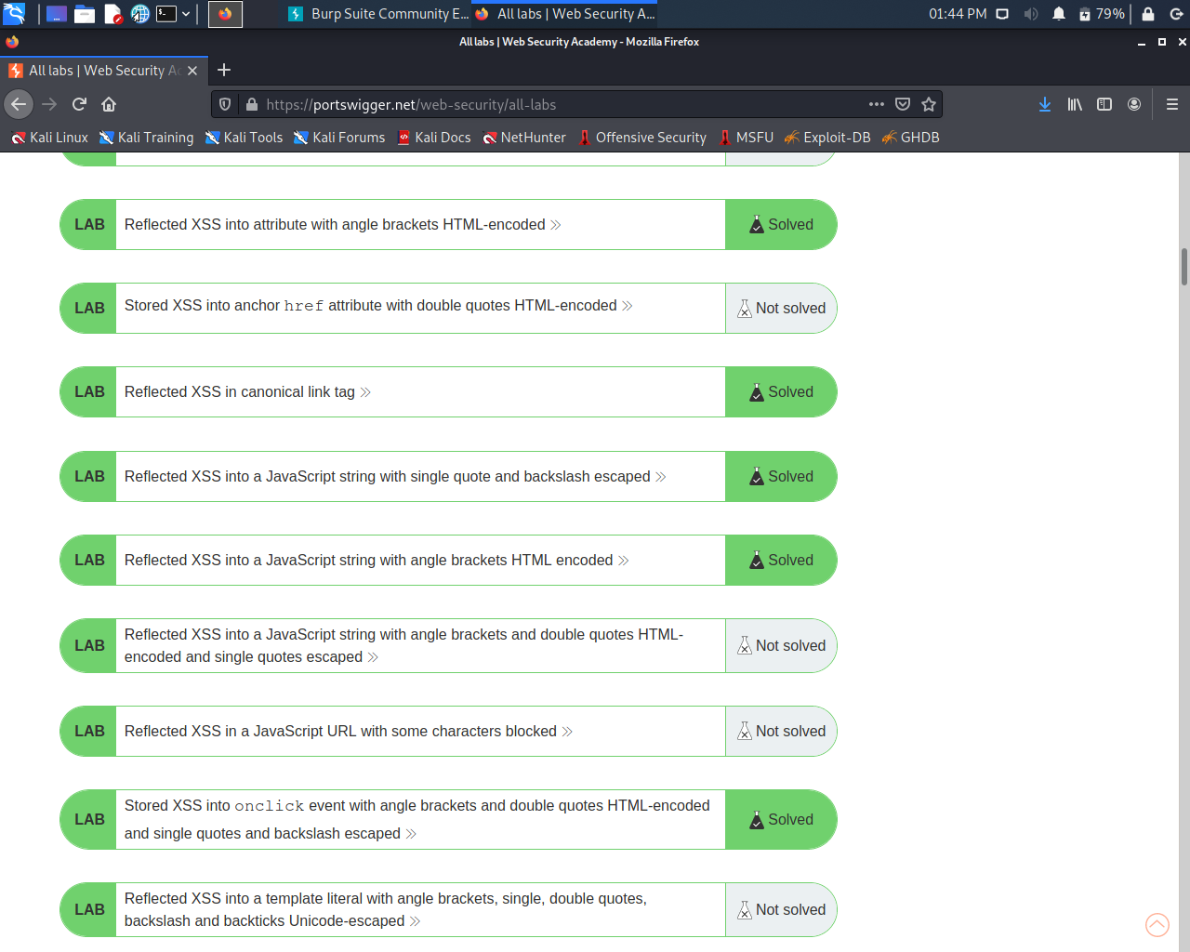
LIST OF SOLVED LABS:
.

Slide 7
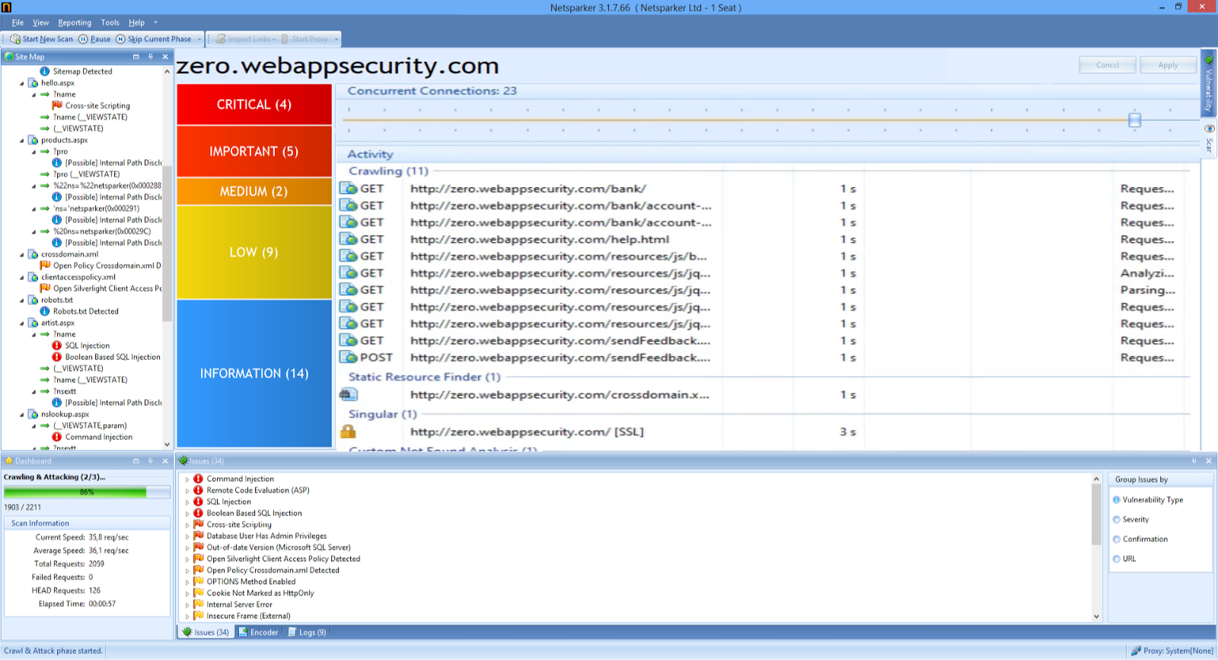
TASK 2: FINDING VULNERABILITIES
Found 4 critical vulnerabilities on the webpage zero.webappsecurity.com

Slide 8
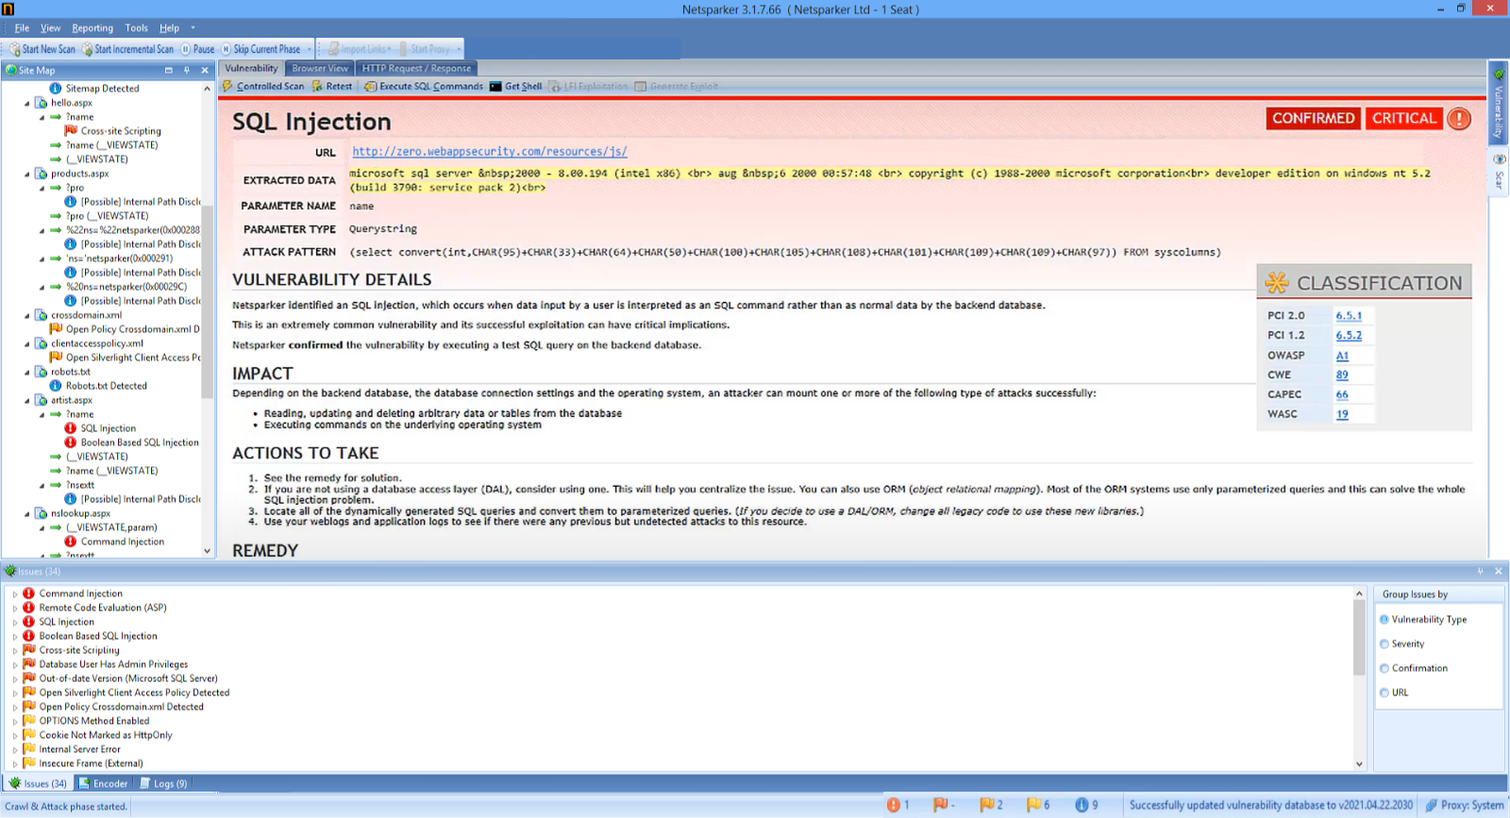
VUlNERABILITY DETAILS, IMPACT AND REMEDY:
Title : CROSS SITE SCRIPTING
domain: websecurity.com
subdomain: zero.websecurity.com
Vulnerability : this site is allowing http method and the X-Content-Type-Header is not set.
IMPACT : http methods like POST ,PUT ,DELETE can be harmful for the website like put method could allow clients to save files on the web server
and DELETE - method can allow clients to remove files on the web server and the X-Content-Type-Header could allow the user agent to render the content of the site in a different fashion to the MIME type.
MITIGATION : configure the web server to return a 405 Method Not Allowed status code. Doing so will reduce the likelihood of HTTP verb tampering vulnerabilities being exploited.

Slide 9
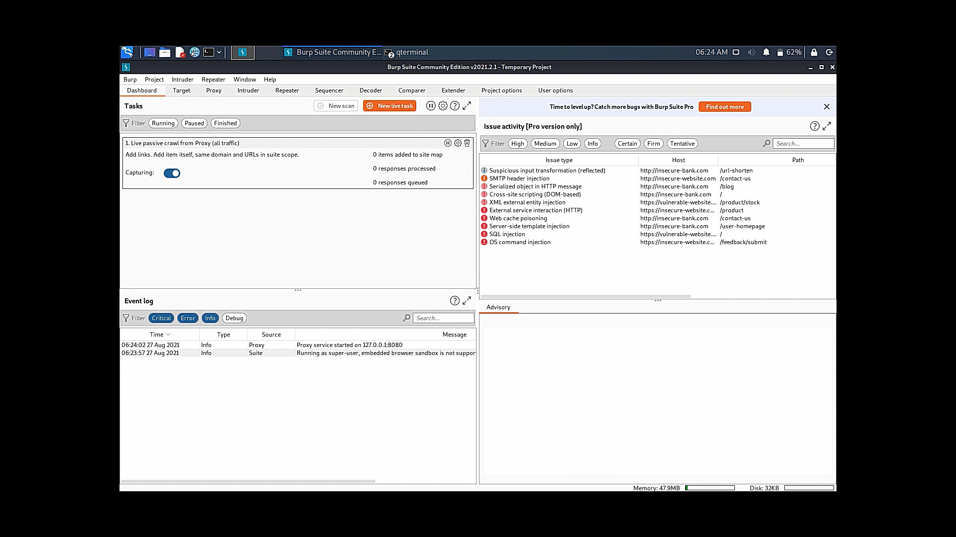
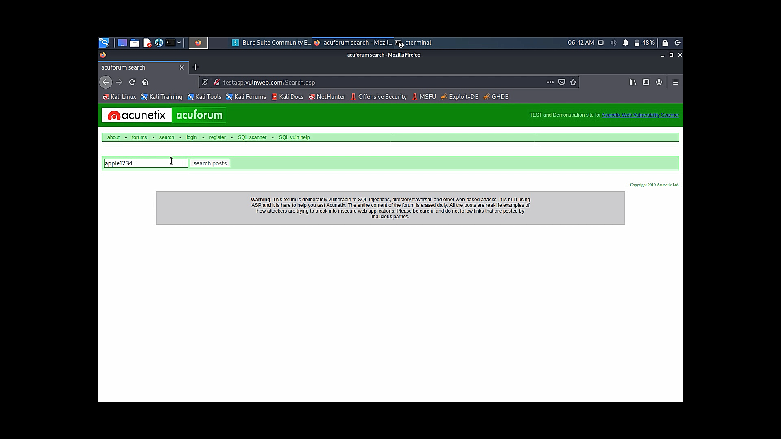
TASK 3: CROSS SITE SCRIPTING(XSS)
domain: vulnweb.com
subdomain: testasp.vulnweb.com
Steps to reproduce -
STEP 1 : visit http://testasp.vulnweb.com/
STEP 2 : on the top menu you will find a search option.
STEP 3 : click on it and you will be prompted with the search box.
STEP 4 : you can intercept the request using burpsuite
STEP 5 : if u type this payload ("broken_site/xss/5?id=<a onmouseover="alert(1)"\>Click me!</a>") in the search box u can see the post posted by admin.
IMPACT : cross site scripting can lead to stealing of user data and in this case it gives access to admins post which can be harmful for your website/company.
MITIGATION : if u want to preventyour website from cross site scripting vulnerability then you can just enable no script on browser.

Slide 10
